Slide 1
Capstone Project
Telecom Churn Analysis

Slide 2
Content
Team Information
Business Problem Overview
Objective
Analysis Based on:
Area Code
States
International Plan
Voice Mail Plan
Customer Service Calls
Challenges
How to Reduce Customer Churn
Conclusion

Slide 3
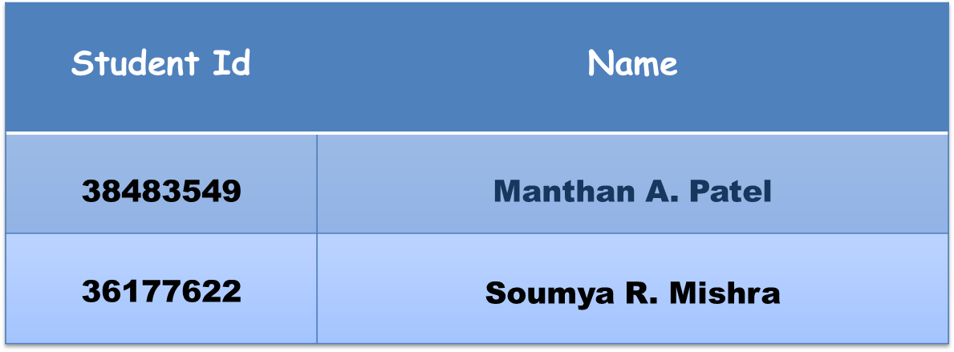
Team Information

Slide 4
Business Problem Overview
Customer churn prediction is extremely important for any business as it recognizes the clients who are likely to stop using their services.
In the telecom industry, customers are able to choose from multiple service providers and actively switch from one operator to another. In this highly competitive market, the telecommunications industry experiences an average of 15-25% annual churn rate.
For many incumbent operators, retaining high profitable customers is the number one business goal.
To reduce customer churn, telecom companies need to predict which customers are at high risk of churn.
In this project, we will analyze customer-level data of a leading telecom firm, to identify customers at high risk of churn and identify the main indicators of churn.

Slide 5
Objective
Finding factors which influence customers to churn.
Retain churn customers by applying strategy.
Providing offers based on influencing factors.
Control churn rate and improve the image in the market.

Slide 6
Data Summary
Data set : Telecom Churn dataset of Orange S.A., formerly France Télécom S.A.
Shape:
Rows - 3333
Columns – 20
Important Columns: State, Area code, International plan, Voice mail plan, Churn, Customer service calls, Total eve calls, Total day calls, Total night calls, Total intl calls.( Probably all columns are important ).

Slide 7
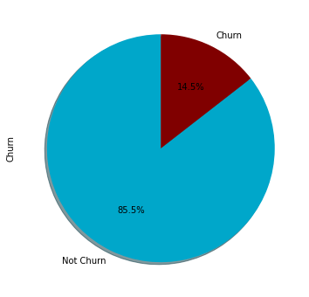
Churn Information
Total Users were 3333.
2850 - Non churn (85.5%)
483 - Churn (14.5%)

Slide 8
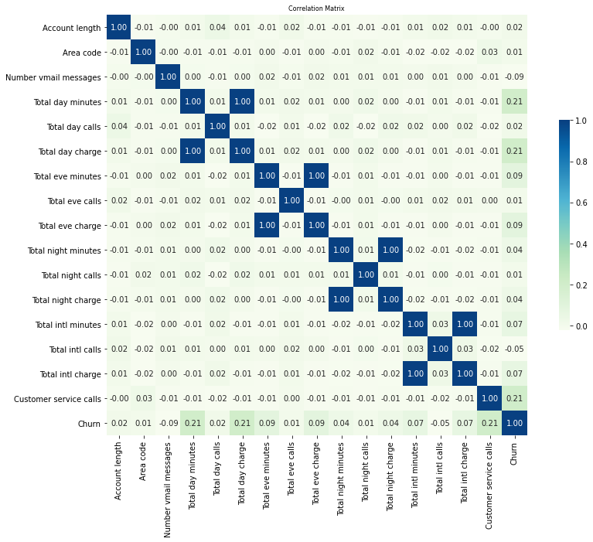
Correlation

Slide 9
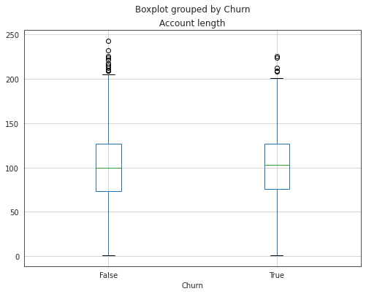
Analysis based on Account Length
The mean of Account length is almost similar for both churn groups.

Slide 10
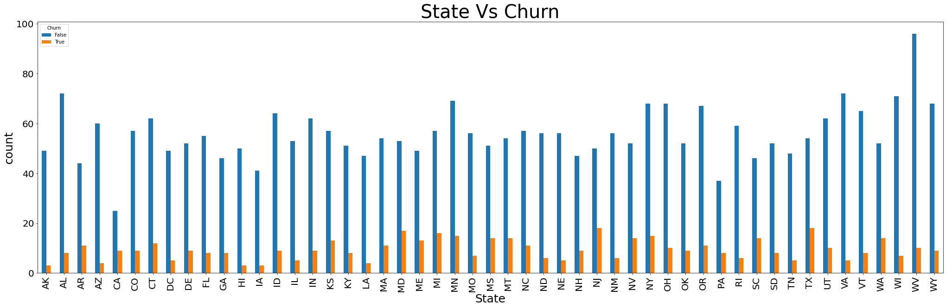
Analysis based on States
There are 51 state who have different churn rate. CA, NJ ,TX , MD ,SC ,MI are
the ones who have higher churn rate more than 21.74% which is more than
50% of average churn rate.

Slide 11
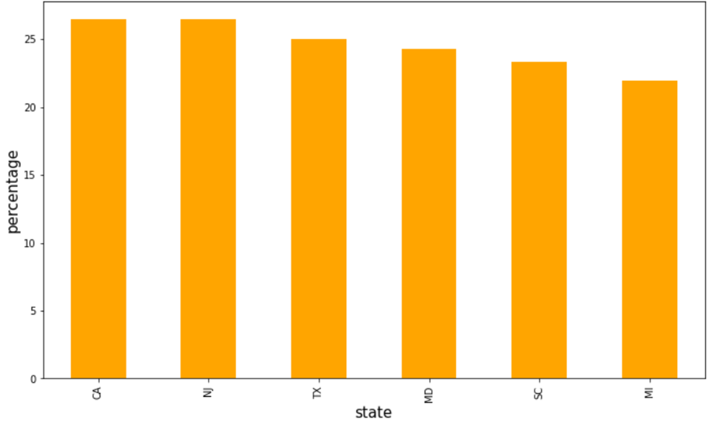
State with most Churn percentage

Slide 12
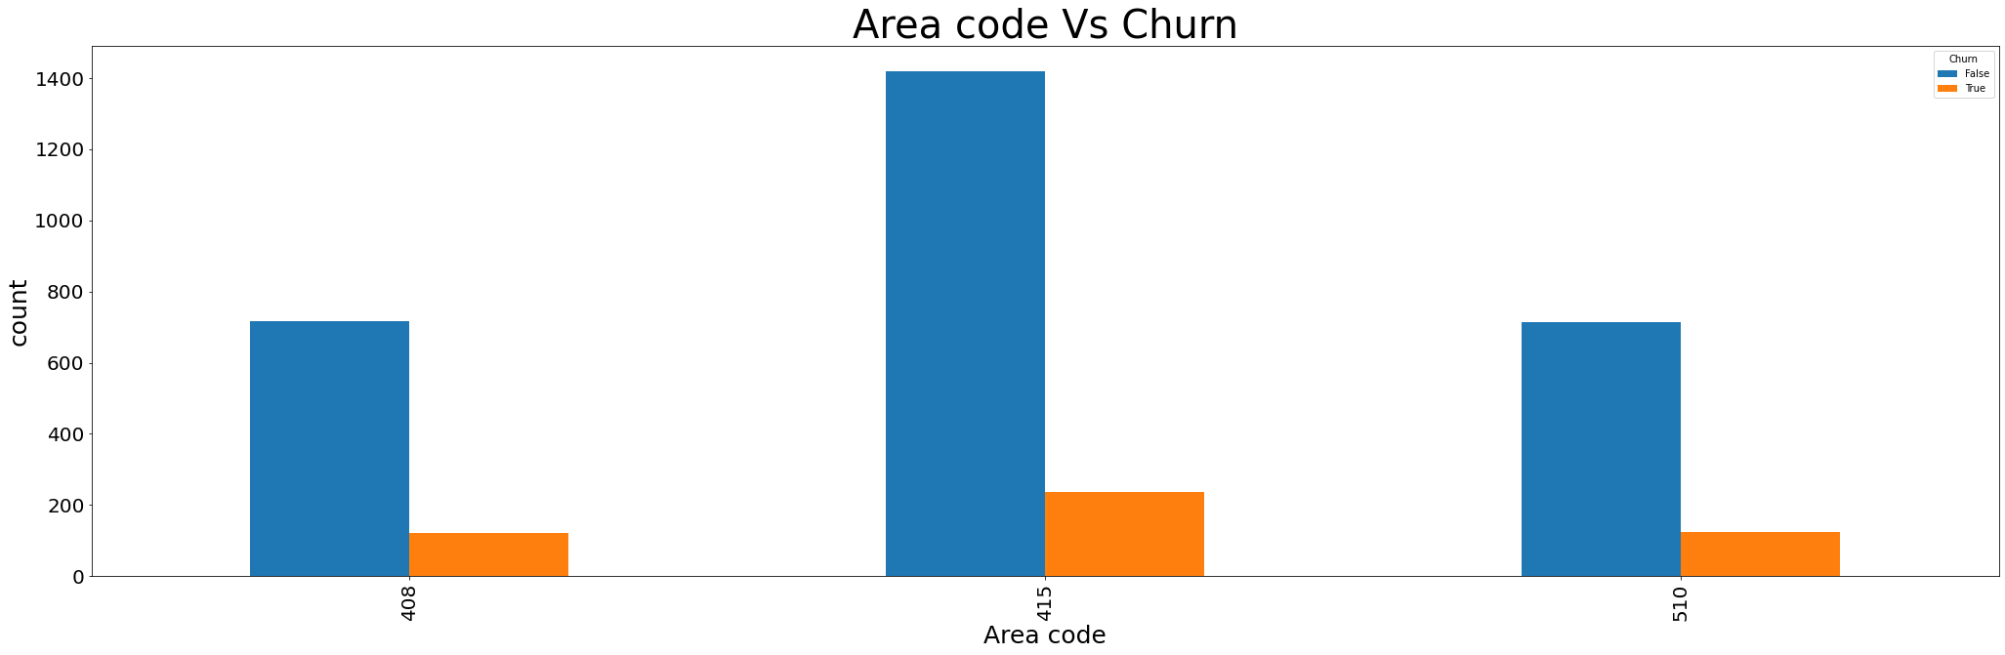
Analysis Based on Area Code
All the Area codes have almost equal (.14%) percentage of Churners.

Slide 13
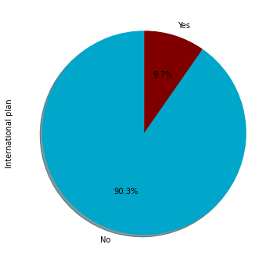
Analysis Based on International Plan
Out of 3333 people only 323 have a International Plan , rest 3010 do not
have International Plan

Slide 14
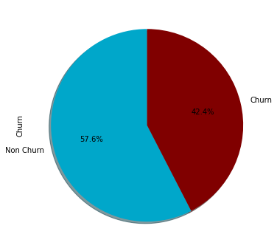
International Plan vs Churn
323 people having International plan about 42.4% are
Churn.

Slide 15
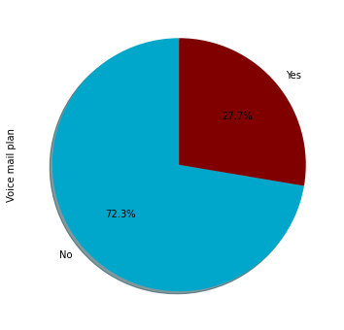
Analysis Based on Voice mail
Out of 3333 people 922 having Voice mail plan, rest 2411 do not have any
Voice mail plan.

Slide 16
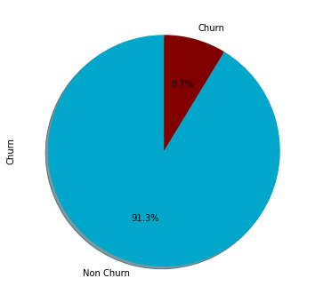
Voice Mail Plan vs Churn
922 people having Voice mail plan about 8.7% are
Churn.

Slide 17
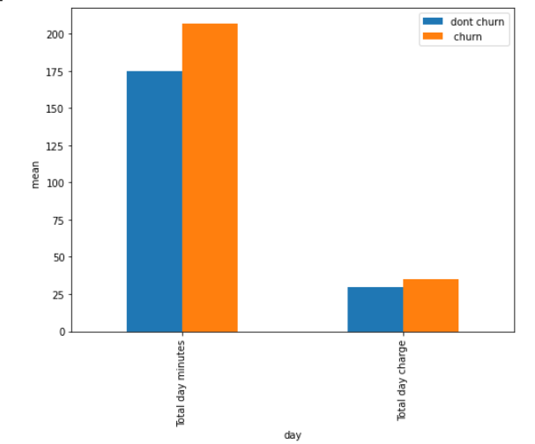
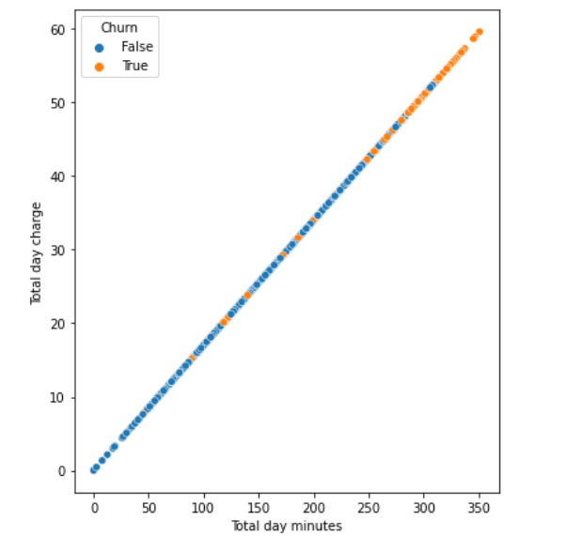
Analysis based on Day Calls

Slide 18
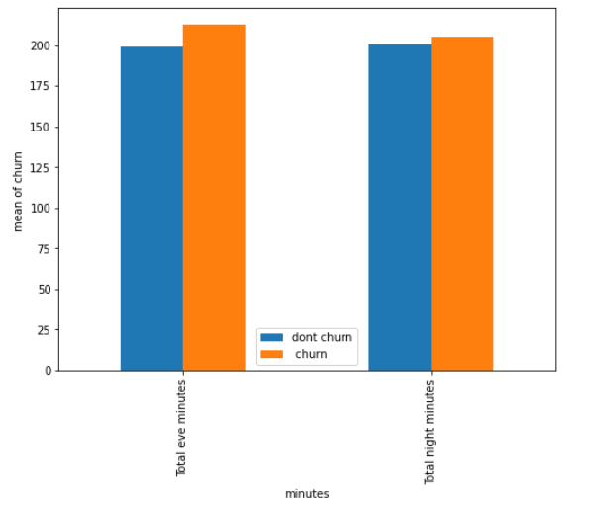
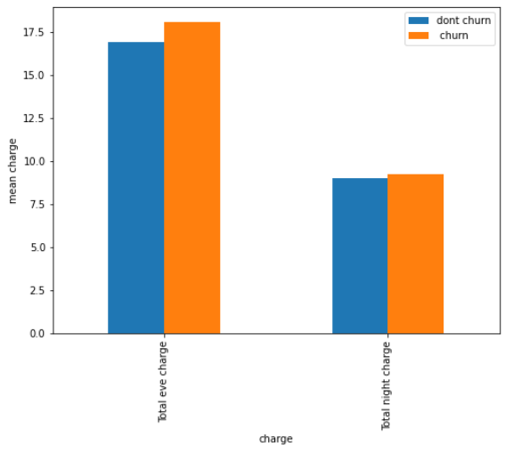
Analysis based on eve/night calls

Slide 19
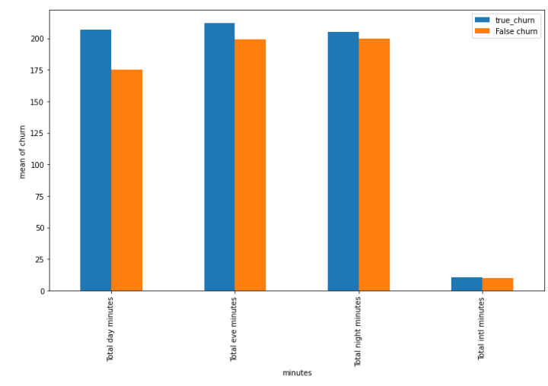
Analysis based on total calls

Slide 20
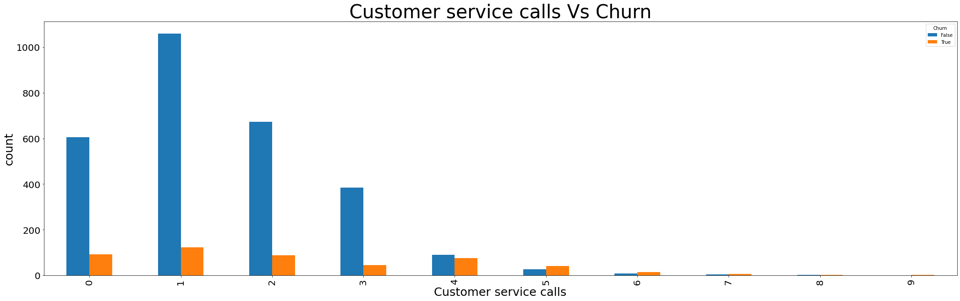
Analysis based on Customer Service Call
Customers with more than 4 service calls their probability of leaving is more.

Slide 21
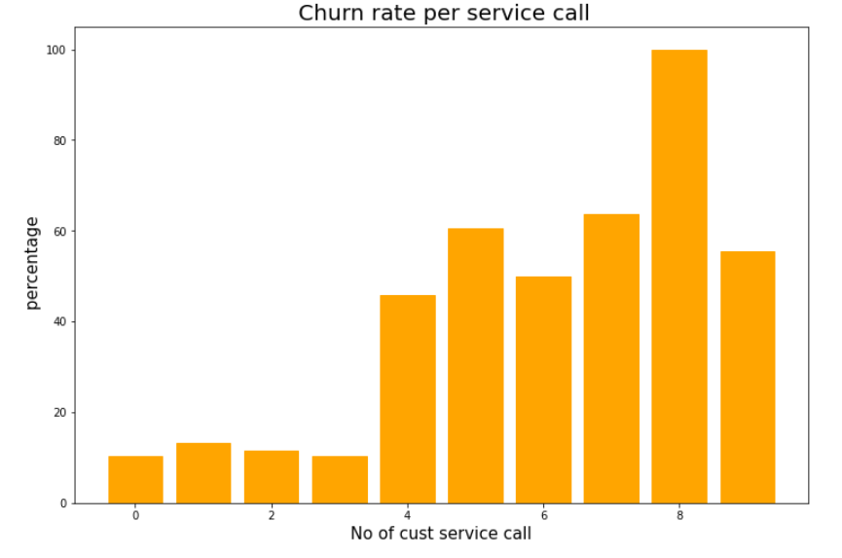
Churn Rate as per Service Call

Slide 22
Challenges
Difficult to recognise columns like- (Account Length , Number vmail messages. Etc.) as while subset these we got lot of possibilities of true churn and have to work for each possibilities.
Need to plot lot of Graph for different States as well as different Area codes to understand the data and handling the data.
Need to subset for respective State having respective Area code till it reaches a dozen of customers.

Slide 23
Solution to Reduce Customer Churn
Modify International Plan as the charge is same as normal one.
Be proactive with communication.
Ask for feedback often.
Periodically throw Offers to retain customers.
Look at the customers facing problem in the most churning states.
Lean into best customers.
Regular Server Maintenance.
Solving Poor Network Connectivity Issue.
Define a roadmap for new customers.
Analyze churn when it happens.
Stay competitive.

Slide 24
Conclusion
The four charge fields are linear functions of the minute fields.
The area code field and/or the state field are anomalous, and can be omitted.
Customers with the International Plan tend to churn more frequently.
Customers with four or more customer service calls churn more than four times as often as do the other customers.
Customers with high day minutes and evening minutes tend to churn at a higher rate than do the other customers.
There is no obvious association of churn with the variables evening calls, night calls, international calls, night minutes, international minutes, account length.

Slide 25
Q & A

